Slide 1
E-retail factors for customer activation and retention: A case study from Indian e-commerce customers
Submitted by:
Bishwajit Bhattacharya

Slide 2
Problem Statement
Customer satisfaction has emerged as one of the most important factors that guarantee the success of online store; it has been posited as a key stimulant of purchase, repurchase intentions and customer loyalty. A comprehensive review of the literature, theories and models have been carried out to propose the models for customer activation and customer retention. Five major factors that contributed to the success of an e-commerce store have been identified as: service quality, system quality, information quality, trust and net benefit. The research furthermore investigated the factors that influence the online customers repeat purchase intention. The combination of both utilitarian value and hedonistic values are needed to affect the repeat purchase intention (loyalty) positively. The data is collected from the Indian online shoppers. Results indicate the e-retail success factors, which are very much critical for customer satisfaction.
I have data details like what is the age of people who is using online platform, cities online platform, since how long they are using, which platform they using , delivery period, products like this.
Now are days people want to get the products on there home, so online shopping is very much important part of daily life.

Slide 3
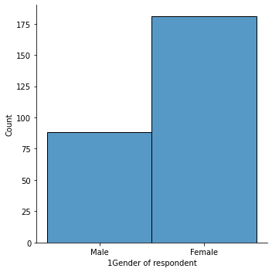
Gender ratio

Slide 4
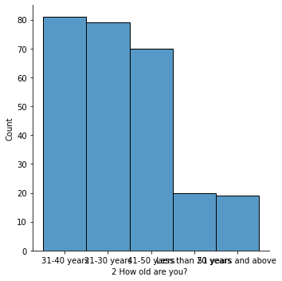
Age description

Slide 5
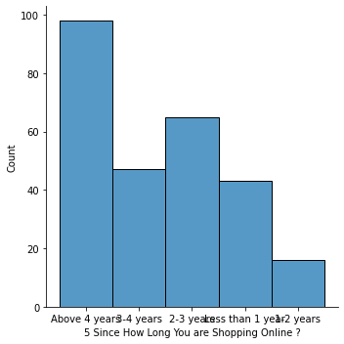
How long shopping online

Slide 6
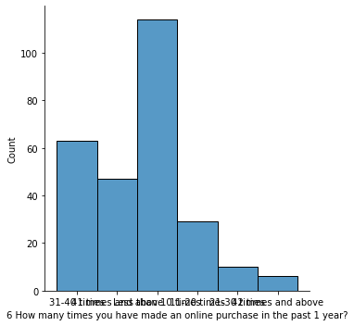
How many time purchase online

Slide 7
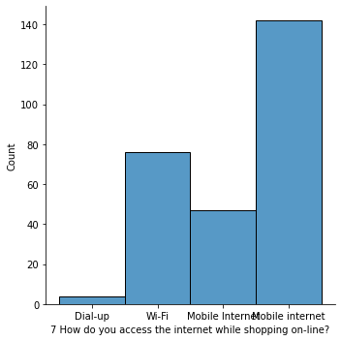
Internet access for online shopping

Slide 8
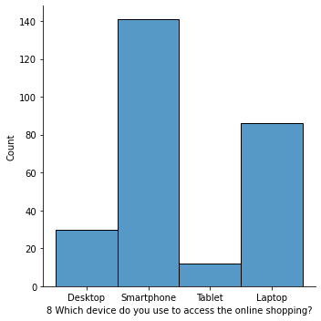
Which device use to access online shopping

Slide 9
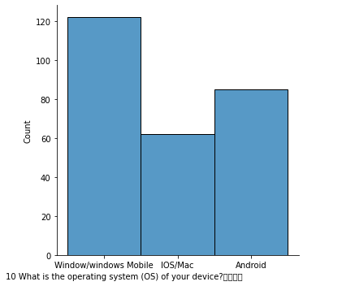
Operating System

Slide 10
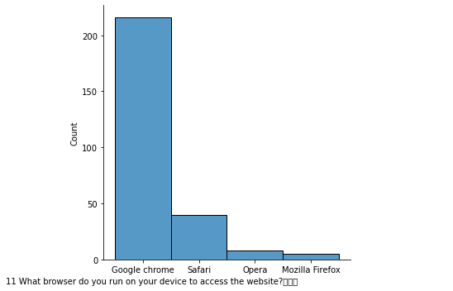
Which browser is use

Slide 11
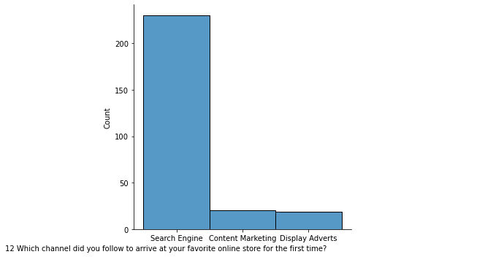
Favourable channel for first time user

Slide 12
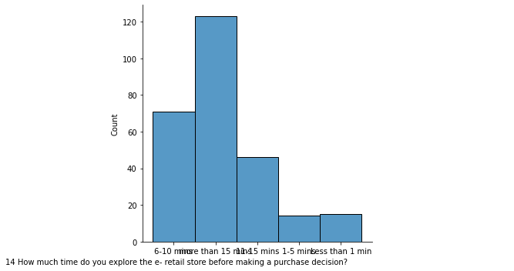
Time taking for purchasing decision

Slide 13
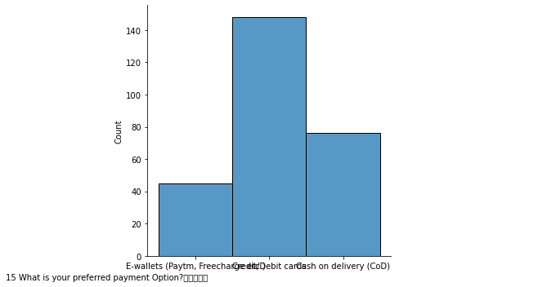
Preferred Payment option

Slide 14
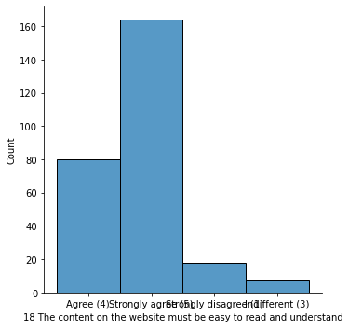
Contain of website must be easy to understand

Slide 15
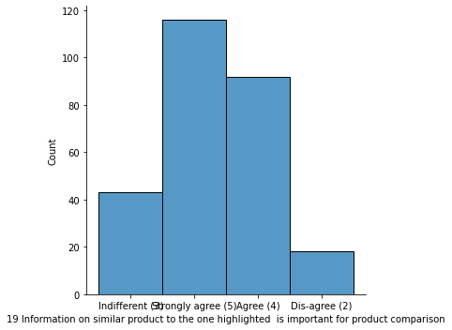
Information on similar product to the one highlighted for product comparison

Slide 16
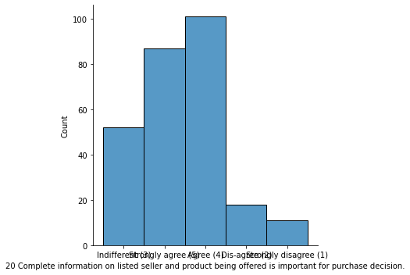
Complete information on seller and product being offered is important for purchase

Slide 17
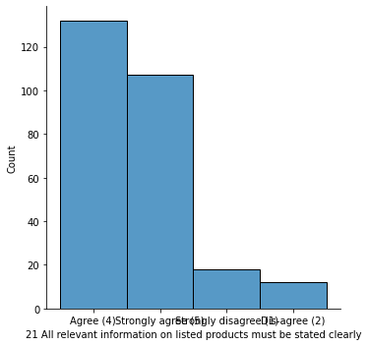
All relevant information on listed products must be stated clearly

Slide 18
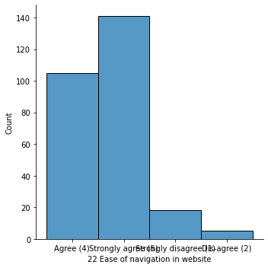
Ease of navigation in website

Slide 19
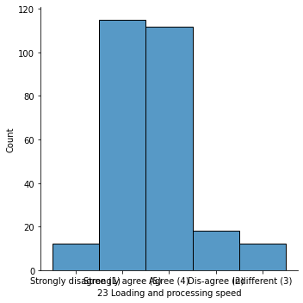
Loading and processing speed

Slide 20
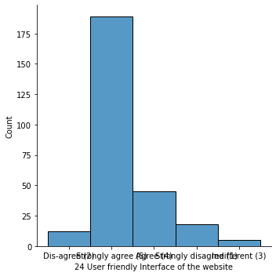
User Friendly Interface of the Website

Slide 21
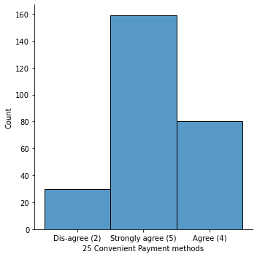
Convenient Payment Methods

Slide 22
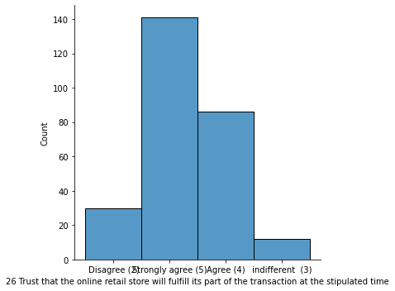
Trust the online store

Slide 23
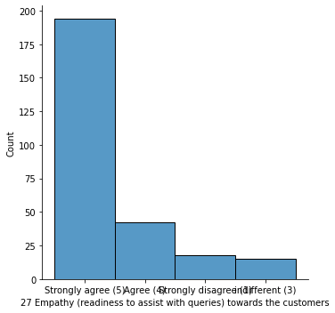
Empathy towards customer

Slide 24
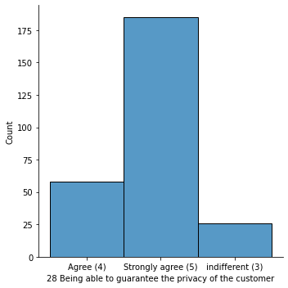
Guarantee the privacy of the customer

Slide 25
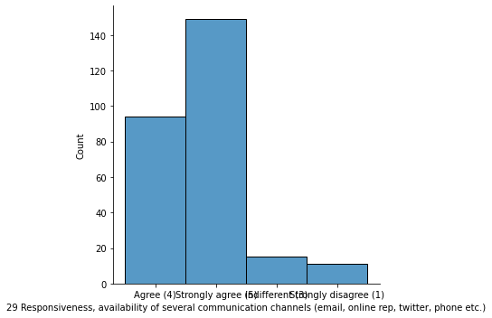
Responsiveness, availability of several channels

Slide 26
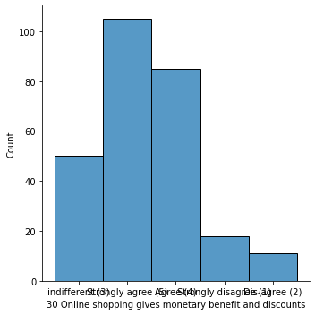
Monitory benefit and discount

Slide 27
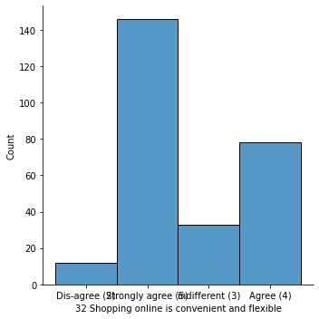
Shopping online is convenient and flexible

Slide 28
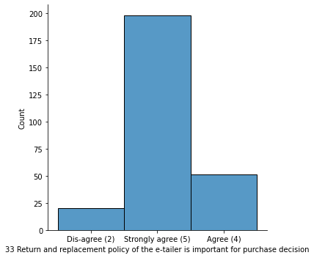
Return and replacement policy

Slide 29
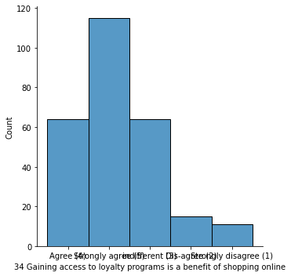
Gaining access to loyality

Slide 30
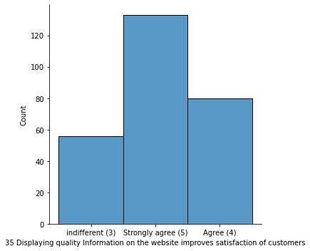
Displaying quality information on the website improves satisfaction

Slide 31
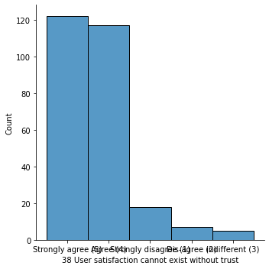
User satisfaction cannot exist without trust

Slide 32
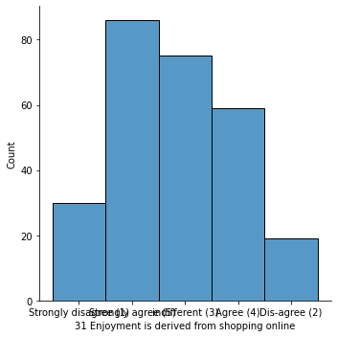
Enjoyment is derived from shopping onlin

Slide 33
Shopping online is convenient and flexible

Slide 34
Return and replacement policy effect on online shopping

Slide 35
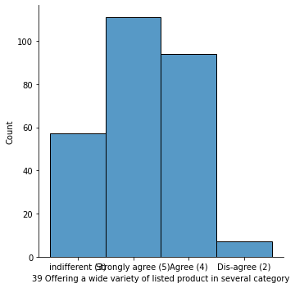
Variety of listed product in several category

Slide 36
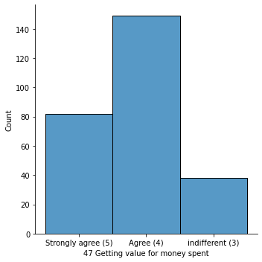
Getting value for money spent

Slide 37
Conclusion
Now are days people want to get the products on there home, so online shopping is very much important part of daily life. In this project i have some data of survey on online shopping. After analyse the data I got some points which are following: -
Mostly female are using online shopping.
31-40 and 21-40 this range of ages people are mostly use online shop.
Online shopping mostly done from smartphones.
Google chrome server is most convenient server now a days.
People mostly use mobile internet for online shop.
People are mostly coming first time online shopping through search engine.
After first visit they come to online shopping either search engine or App.
Decision to purchase product took almost 15 minutes or more for customer.

Slide 38
People mostly use debit card for purchase.
People are satisfying if contain of website is easily read and understandable.
If they got lots option for their desire product, they will happy.
Now are days Customer easily filter their desire product because they got lots of option.
Customers will come to the website more if they trust the website.
Online shopping more flexible and convenient.
Here customer easily can get all the specification of the product.
If the website is user friendly and easily accessible, customer will more attract.
Convenient payments method is very much important part for online shopping.
Customer care part is very much important, they should give empathizes towards customer.

Slide 39
The system should guarantee privacy of their customer, also they should responsible and easily available on several channels for customer.
If customer got more discount or other benefit for their purchase, they will more shop from the particular website.
Product review’s is important towards shopping.
Return replacement policies are advantageous for online shopping.
People easily can get their desire retail shop from online platform.
Customer got enjoyment and also improved their social status by online shopping.

Slide 40
Now are days we have several online platforms likes, Amazon, Flipkart, Paytm, Snapdeal, Myntra. Amazon and Flipkart people use more than others.
As we see there is lots of advantageous for online shopping, and I feel now is necessary also of this pandemic situation, as online shopping is safest.

